Slide 1
Capstone Project - The Battle of Neighborhoods Munich vs. Berlin¶
by Philipp Hock January 11, 2021

Slide 2
Munich vs. Berlin Table of content
Introduction/Business Problem
Munich:
Data import and cleaning
Analyze Boroughs
Berlin
Data import and cleaning
Analyze Boroughs
result and discussion
Trending venue

Slide 3
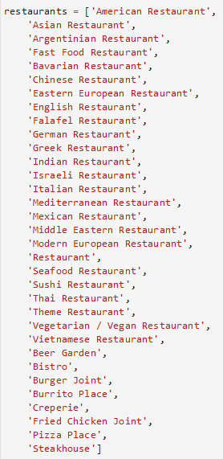
Munich vs. Berlin Introduction/Business Problem
Two of Germany's most wanted cities are Berlin and Munich.
where can I find a restaurant?
which restaurants have the highest user ratings?
and of course, can I afford that?
Approach:
venue categories offered by Foursquare.
Define suitable restaurant categories.
the k-means clustering algorithm to split restaurant into clusters
Folium library to visualize the neighborhoods in Berlin and Munich
Based on the results, my wife can decide whether she will have dinner in Munich or Berlin and to which borough I have to navigate her.
But as soon as we arrive, we will look for the places with the highest foot traffic. So let's do that and get the trending venues around.

Slide 4
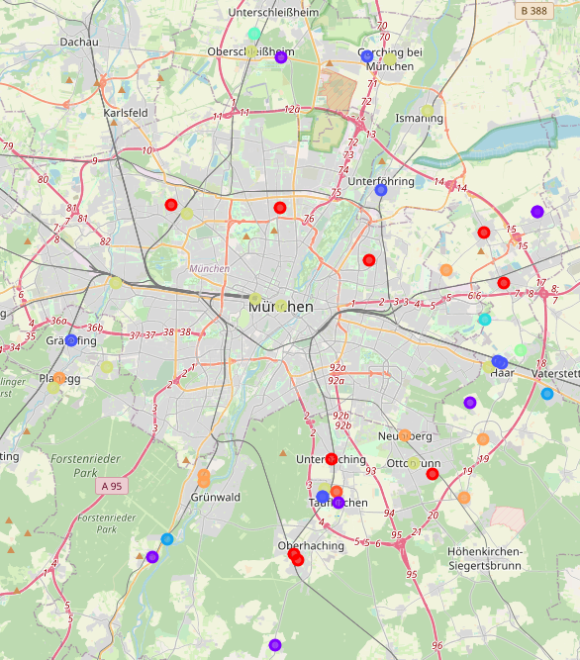
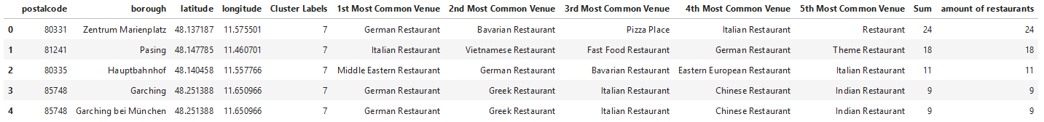
Munich vs. Berlin Munich: Data import and analyze Boroughs
6
Data import with BeautifulSoup
Nominatim for munich Latitude and Longitude
Get nearby venues from Foursquare
group rows by neighborhood and mean frequency of occurence of each category
Cluster Borough with k-means
Merge and visualize
Sum amount of restaurants and print top5
1
2
5
3
4
7

Slide 5
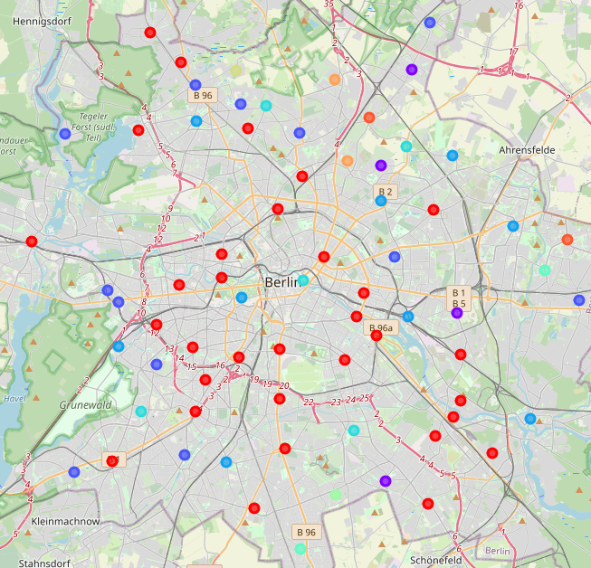
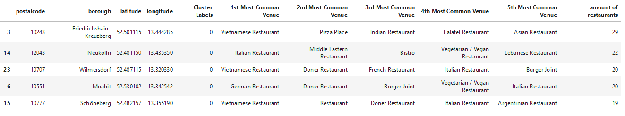
Munich vs. Berlin Berlin: Data import and analyze Boroughs
6
Data import with BeautifulSoup
Nominatim for munich Latitude and Longitude
Get nearby venues from Foursquare
group rows by neighborhood and mean frequency of occurence of each category
Cluster Borough with k-means
Merge and visualize
Sum amount of restaurants and print top5
1
2
5
3
4
7

Slide 6
Munich vs. Berlin result and discussion
Berlin - Friedrichshain-Kreuzberg has the highest number of restaurants of 29.
Munich - Marienplatz seems also to be a good choice with 24 different restaurants.
So she will decide based on most common restaurants.
As soon as we arrive, we will look for the places with the highest foot traffic. So let's do that and get the trending venues around.

